Slide 1
Identity Services @ MIT a strategic view for IS&T/ISDA
Version 1.1
June 5, 2008

Slide 2
Identity Services (IdS) Defined
Information used to maintain a profile of a person is “Identity” data. Identity data is used to allow access to online resources and maintain individual and institutional brand.
Identity Services are sets of capabilities to allow identities access to online resources. Applications use IdS to manage online communities.
Identity Services include Authentication, Authorization, Groups, Privileges, Identity lifecycle, Directories, Federations and federating technology.

Slide 3
Vision
Enables internal and external collaborations
  Federated access for faculty, researchers & students
Transparent and easy to use; reduced support
Improved and timely access to MIT services
Improved security via better identity control
Respect privacy of users and community
Easy integration for Apps and developers
Near real-time (de-)provisioning to Apps
Services built on technology used globally

Slide 4
Goals
All IS&T applications use Identity Services
Majority of MIT uses Identity Services
MIT active in Federated services
Federated access beyond the web browser (such as N-Tier problem, mobility)
Provide Federated capability to HPC platform
Alignment of IdS and business processes
Reliable services (24x7 infrastructure)
Support needs of MIT Student Vision project

Slide 5
Value/Benefits of IdS
Reduce duplication of effort for developers
Developers concentrate on Apps; not IdS
Increased choice of Apps to community
Insulate Apps from evolving IdS technology
More rapid App integration into MIT infra
Consistent user experience for App access
Increase importance/value of MIT brand

Slide 6
Gaps (functional)
Not yet federated with other institutions
  NSF/NIH want collaborative cyber-infrastructure
Current technology web browser oriented
  No effective solutions for N-Tier problem (portals) and non-browser applications
Identity business processes not fully aligned with technology capabilities or other business needs
Kuali Student App needs not fully defined, yet

Slide 7
Approach
Identify MIT-only assets viable/needed for global usage
Identify MIT-only assets where non-MIT solutions are more appropriate or viable. Contribute back to community.
Make change wisely – demonstrate value as we go
Characteristics of Services & Software
  standard protocols and data formats
  Real time updates and access (data feeds only where required)
  24x7, scalable, reliable, modular, serviceable
  Integrates easily with vended and OSS products
  SDKs for developers
  used by others, especially in higher education
  Audit-ability

Slide 8
Trends & Drivers
On the Internet, it’s all about Identity (Burton Group)
Some existing MIT technology is 10-20 years old, MIT-specific, hard to integrate
Federation – Collaboration with external organizations preserving credentials, affiliation and control.
Sourcing – Apps moving inside to outside and back again. Identity needs to be consistent.
Identity theft on the rise !!
  Real criminals now on the net, not just hackers

Slide 9
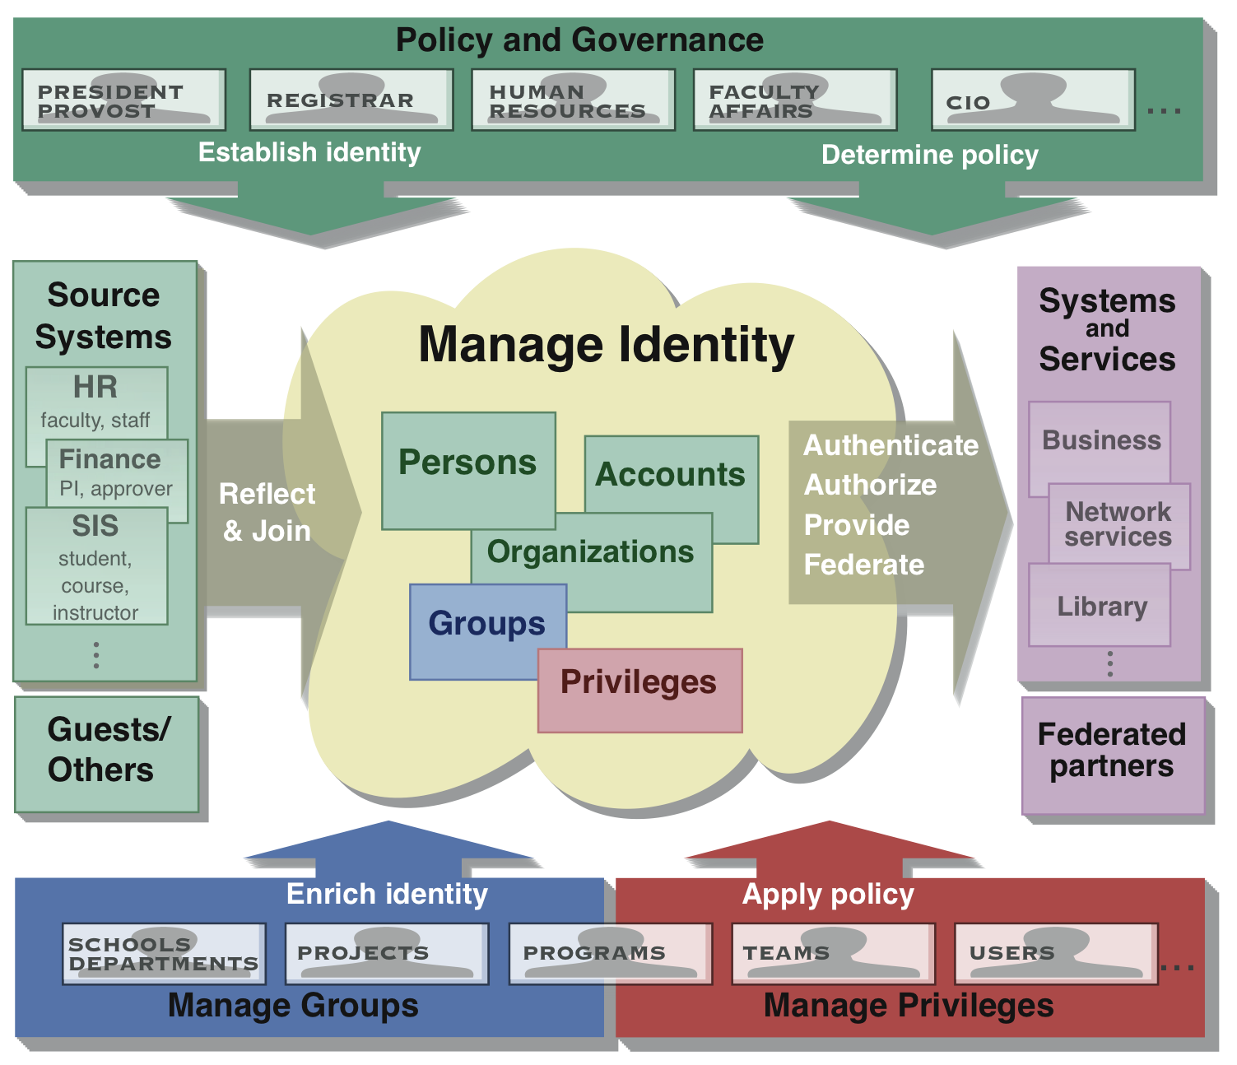
Conceptual Architecture
Image courtesy of National Science Foundation Middleware Initiative

Slide 10
Dependencies & Assumptions
MIT wishes to preserve its prominent identity
MIT wishes to collaborate in global science
IdS shall be a managed resource for most of MIT
IdS shall be as reliable as power, water & phone
Emerging Applications like Kuali Student and DOS will help define needs for evolving IdS

Slide 11
Risks (of providing IdS)
Centralization concerns:
  Single point of failure (if IdS breaks then access to relying services may be interrupted)
  DLCs might perceive IS&T as obstacle or overseer
If not seen as good enough, the community will do its own thing
Perceived fear: Standardization sometimes stifles innovation
Business processes not aligned for near real-time delivery of identity data

Slide 12
Risks (of not providing IdS)
The Balkanization of identity in the community
Administrative inefficiencies will increase
Significant overhead and complexity for users
Duplication of IT effort & development
Institutional identity lost (i.e. goes to ~Google)
MIT becomes lead story in the news because of Privacy Spills or increased identity theft

Slide 13
Summary
Identity Services are
  Critical cyber-infrastructure
  Essential to enable collaboration for research & education according to NSF, NIH and other funding bodies
  Fundamental to representing MIT brand, globally
  Key to securing MIT electronic assets
  Evolving and addressable in the next 3 years
IS&T/ISDA is the appropriate locus to develop IdS

