Slide 1

Assistive Technology
Using AT to Create Comfort in Hybrid Work
IT Partners Conference June 20, 2023
Disability and Access Services (DAS)
Brianna Giacoppe, Assistant Director of Assistive Technology
bgiacopp@mit.edu
Kate Quinn, Assistive Technology Specialist
quinnk@mit.edu

Slide 2
Disability and Access Services (DAS)
Our Mission:
We enable an accessible campus experience at MIT by ensuring access for qualified students with disabilities, and consulting on digital accessibility, assistive technology, and user experience.

Slide 3
For those seeking accommodations for a disability:
For students:
Disability and Access Services (DAS) https://studentlife.mit.edu/das
For employees:
MIT Disabilities Services and Medical Leaves Office (DSMLO) https://hr.mit.edu/disability-services

Slide 4
Topics:
Peripheral devices for comfortable computing
  Ergonomic keyboards
  Ergonomic pointing devices
Dictation Technology
Contact Us
Questions?

Slide 5
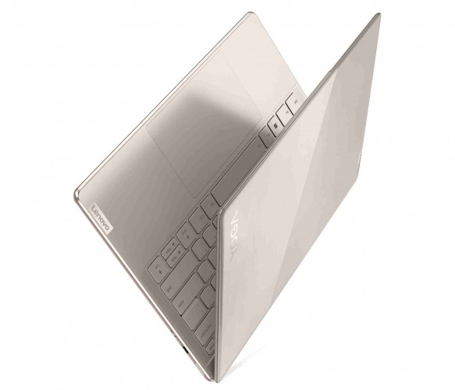
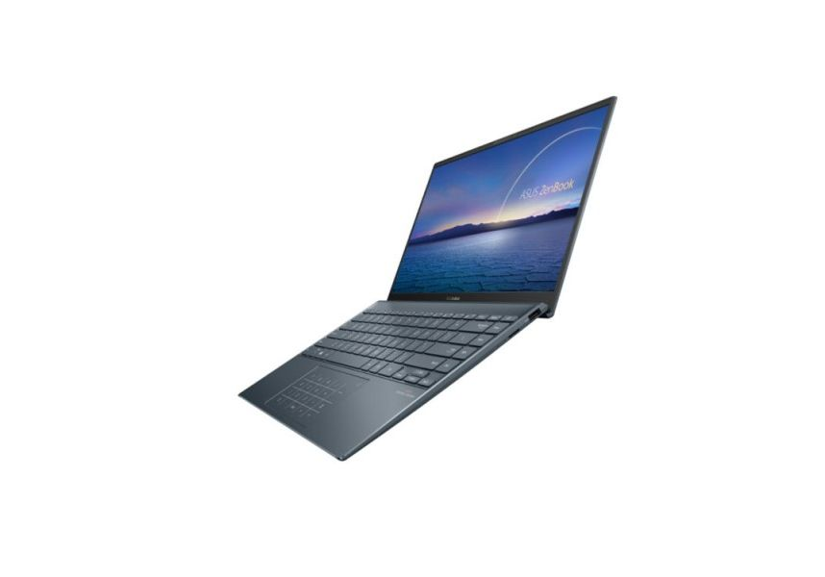
The trouble with laptops
Intended to be portable (slim, lightweight)
  Not built for comfort
Keyboard and trackpad are small, lack physical customization
  Prolonged use can result in poor posture, discomfort, and RSIs

Slide 6
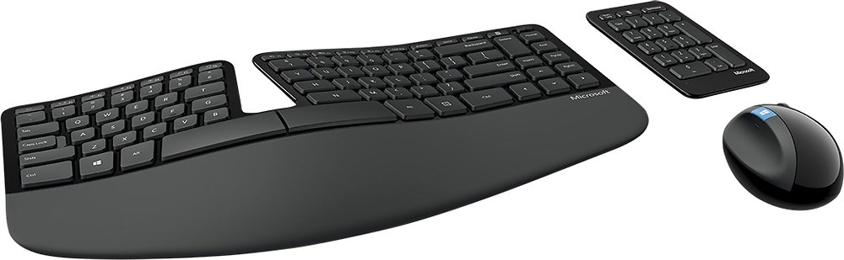
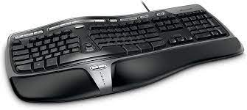
Ergonomic keyboards: waved models
Microsoft Sculpt
Microsoft Natural

Slide 7
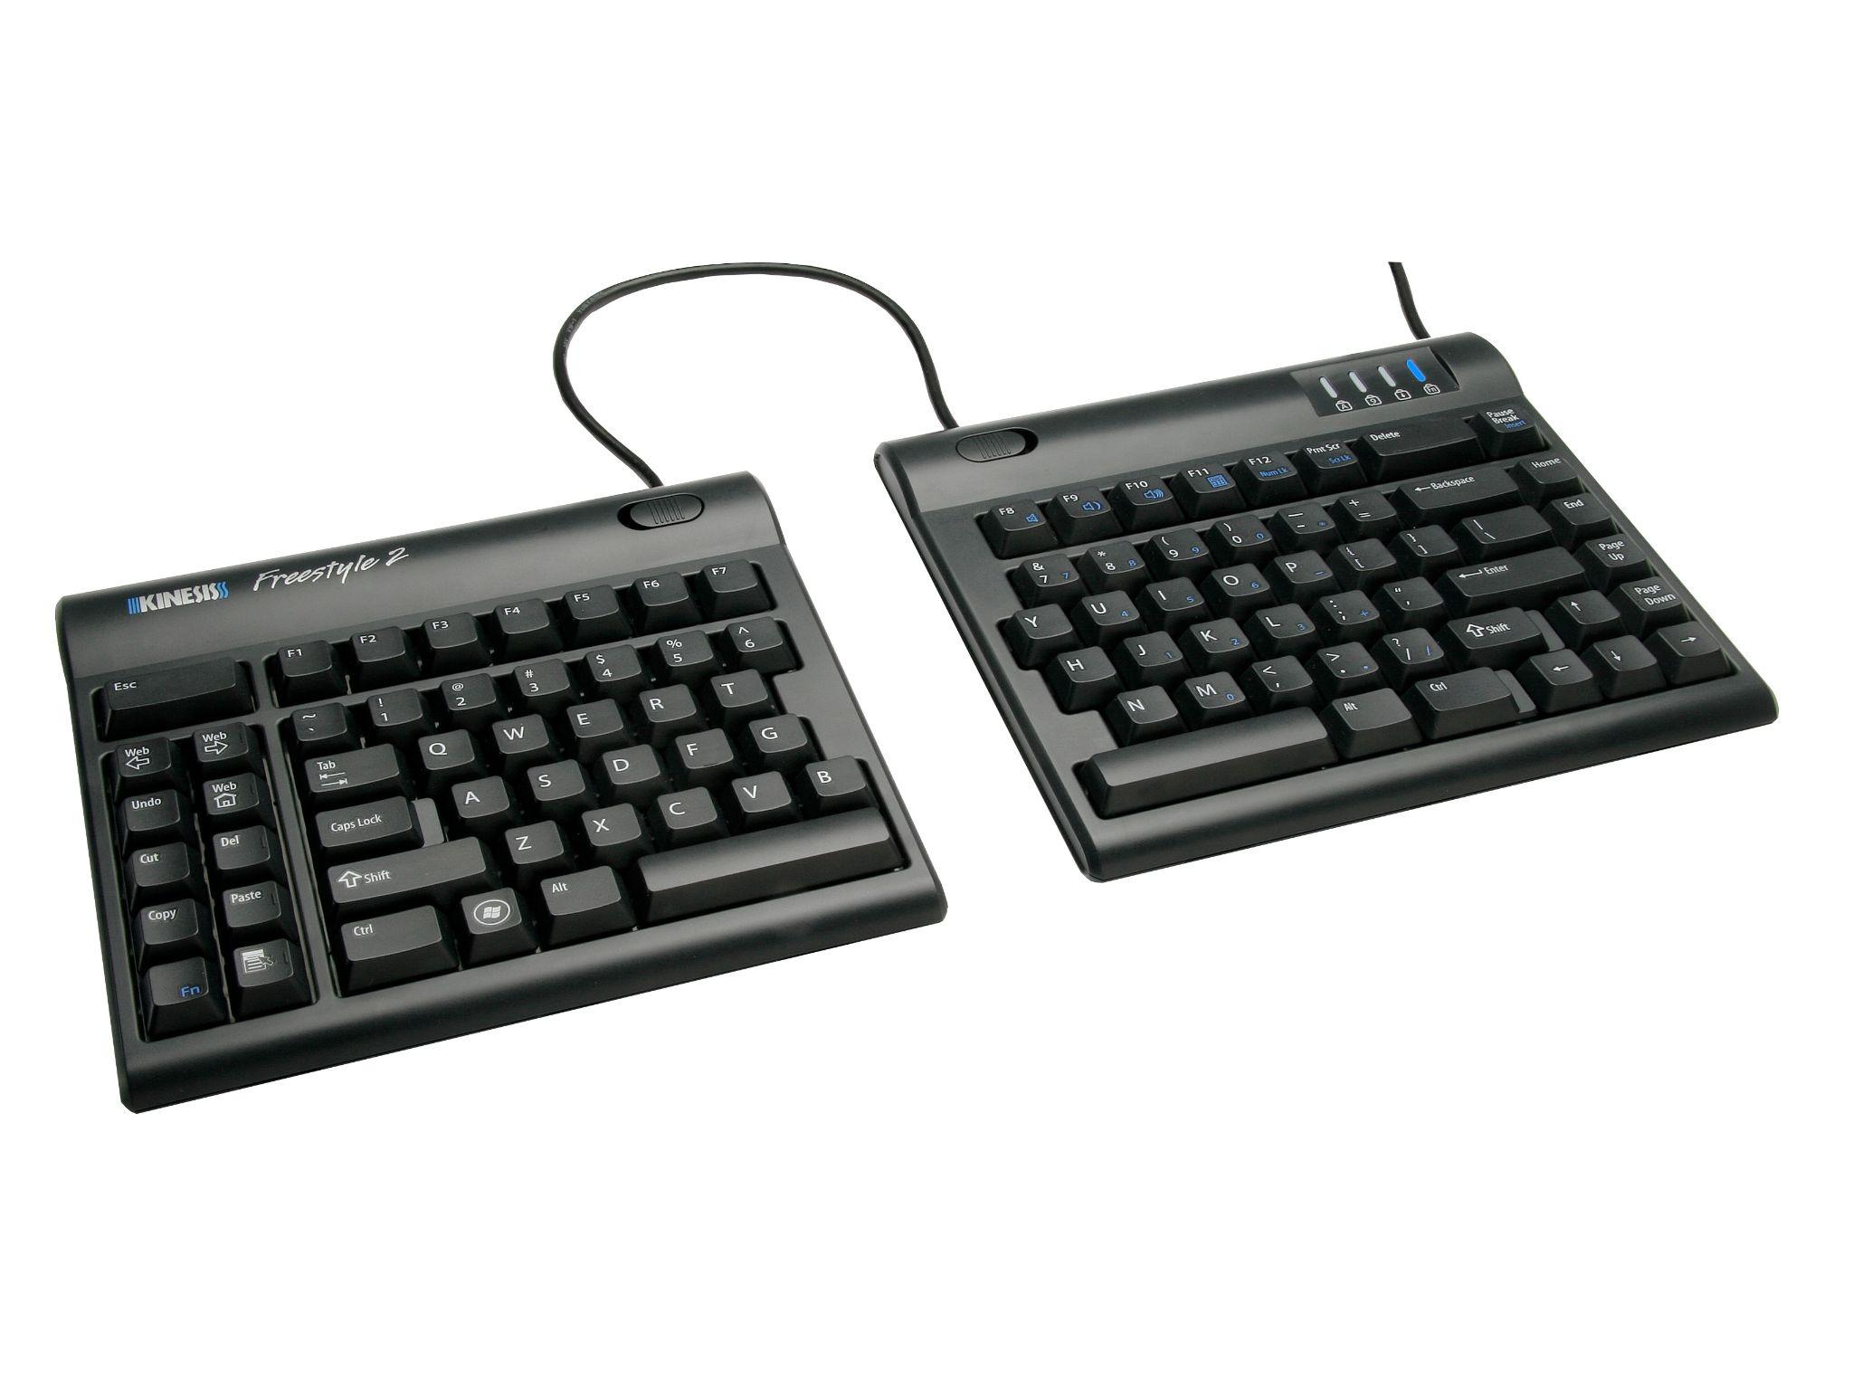
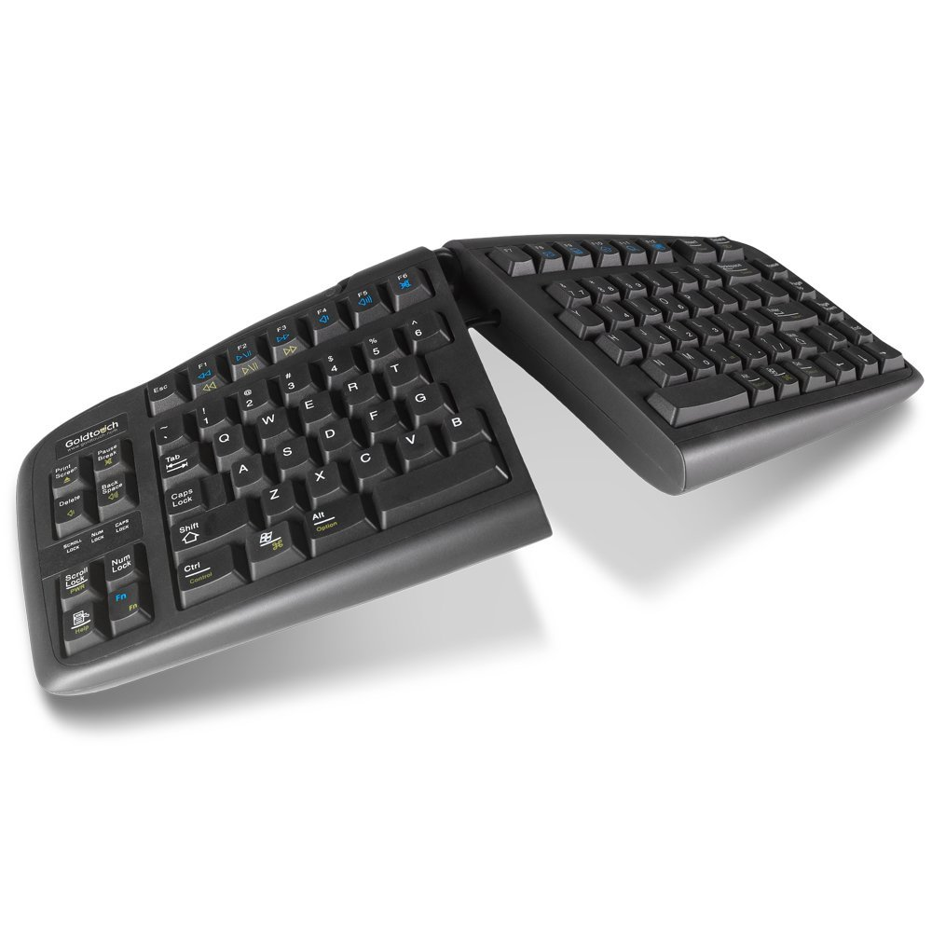
Ergonomic keyboards: split models
Kinesis Freestyle
Goldtouch V2

Slide 8
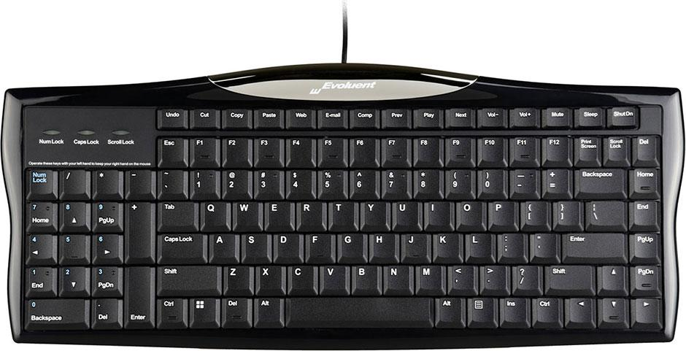
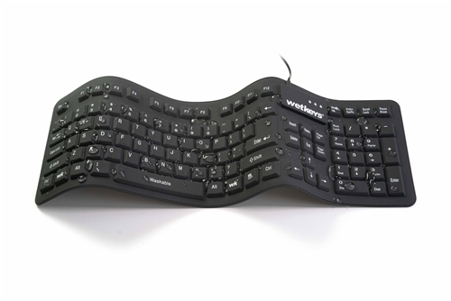
Other keyboard models of note:
Evoluent Reduced Reach
Wetkeys

Slide 9
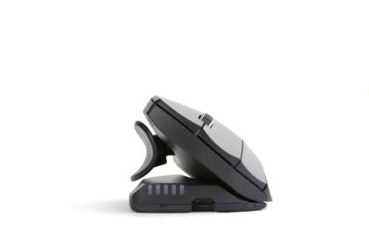
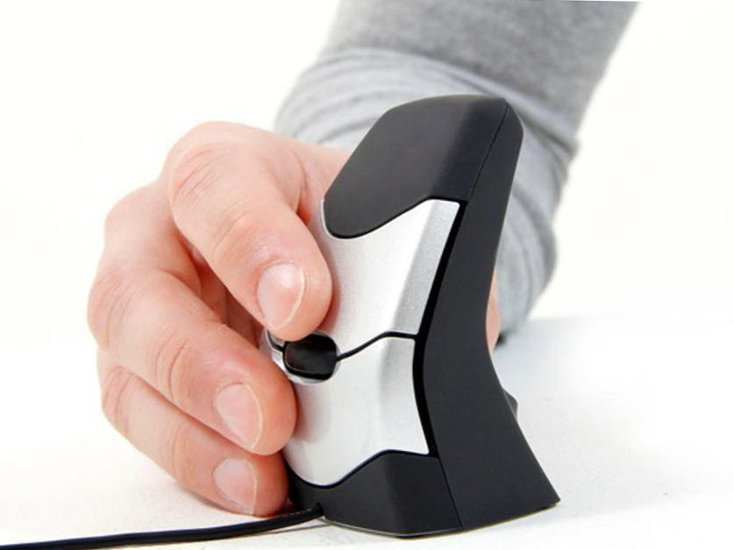
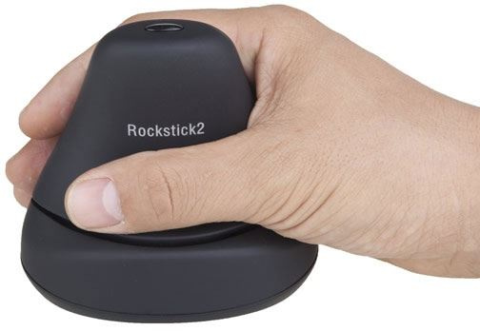
Ergonomic mice: vertical and adjustable models
DXT Mouse
Contour Unimouse
Rockstick Mouse

Slide 10
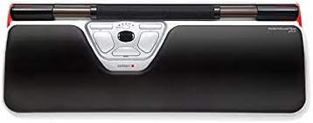
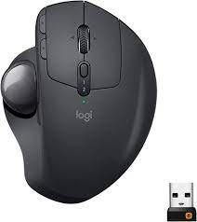
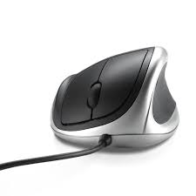
Ergonomic mice: other models of note
Logitech MX Ergo Trackball
RollerMouse Red
Goldtouch Mouse

Slide 11
Dictation Technology
What is Dictation?
An Assistive Technology (AT) that allows users to utilize their voice to write, rather than their hands or upper extremities
Other names for Dictation
Voice-to-Text
Speech-to-Text
Voice Recognition
Speech Recognition
Voice typing

Slide 12
Dictation
How is Dictation Helpful?
Helpful to any technology user who needs a break from typing on their keyboard, phone, or tablet device
Benefits:
  Increased writing time
  Efficient spelling access
Provides increased access to those with:
  Physical disabilities
  Language-processing disorders
  Injuries to their upper extremities

Slide 13
Types of Dictation
Voice Control and Dictation on Mac and iOS
Voice Typing in Windows
Dragon Naturally Speaking
AI Generate Dictation
Alexa and Siri

Slide 14
Contact Us
Disability and Access Services - Assistive Technology
https://studentlife.mit.edu/das/assistive-technology
W20-507 (reopening this fall)
atic-staff@mit.edu
617-253-7808

Slide 15
Questions?

